Slide 1
Job Recommendation Engine
International School of Engineering
Final Project Report
By
Vijay Prayagala (Batch 14 – 2016)

Slide 2
Agenda
Project Definition
Data Gathering
Data Pre-Processing
Methodology/Approach
Problem with Data and Approach to Overcome that
Model Building Approach
Evaluation of Model
Solution Steps
Results
What could have been done?
Questions

Slide 3
Project Definition
Quickhire is a US based job portal. The portal is becoming quite popular among seekers for part-time jobs. They have collected all the data related to jobs and candidates in their portal.
Building a Recommendation system based on collaborative filtering and enhance the recommendations using Applicant Profile/Job Profile like distance between the job and candidate’s location and type of industry

Slide 4
Data Gathering
Applicant Data and Job data has been collected by Quick Hire.
Job Data | Applicant Data | Rating Data
Combined_Jobs_Final.csv | Main_Info.csv | TrainingData.csv
MainJobViews.csv | Languages.csv
JobViews.csv | Credentials.csv
 | Education.csv
 | Expereince.csv
 | Leadership.csv
 | Interests.csv
 | Positions_Of_Interest.csv

Slide 5
Data Preprocessing
Picked below relevant files and the specific attributes in them.
File Name | Attribute Names
Main_Info.csv | Applicant.ID, Latitude, Longitude
Education.csv | Applicant.ID,Graduate.Year,School.Name,City,Degree
Positions_Of_Interest.csv | Applicant.ID,Position.Of.Interest
Combined_Jobs_Final.csv | Job.ID, Title, Position, Job.Description, Latitude, Longitude, Employment.Type, Education.Required, Industry
MainJobViews.csv | Applicant.ID , Job.ID, Job.Applied
TrainingData.csv | ApplicantID, JobID, Rating

Slide 6
Data Pre-Processing
Converting the Rating data into Matrix Format
Rows are Applicants
Columns are Jobs
Use ‘acast’ to convert the training data into matrix format – 3027 X 6270
Understanding Rating data
Rating Matrix Sparsity: 99.95884 % , only 0.04116 % filled with ratings
Distribution of Applicants (plot) - number of applicants rated for a job
Distribution of Jobs (plot) - number of jobs rated by applicant

Slide 7
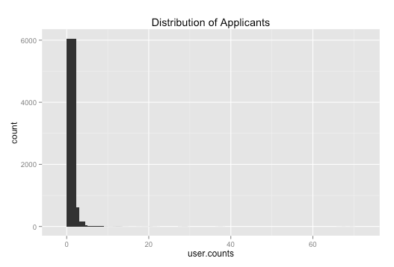
Data Pre-Processing

Slide 8
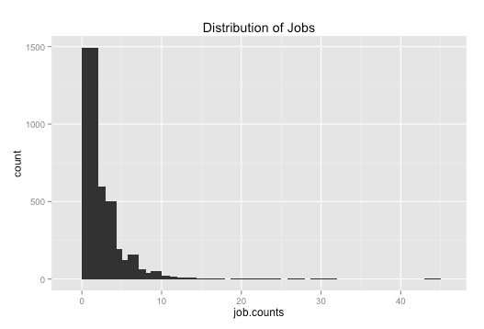
Data Pre-Processing

Slide 9
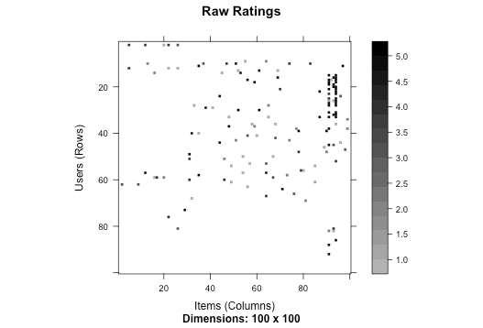
Data Pre-Processing
Image on Processed Rating Matrix

Slide 10
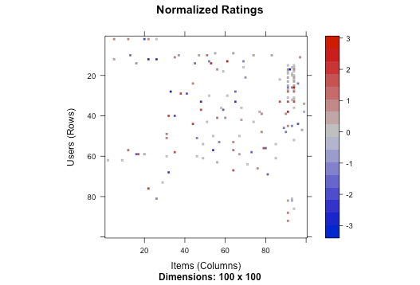
Data Pre-Processing
Image on Normalised Rating Matrix

Slide 11
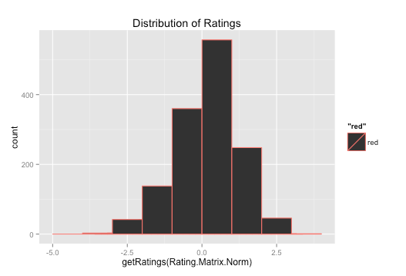
Data Pre-Processing
Frequency of Ratings

Slide 12
Methodology/Approach
Some of the Problems with Data
Data Sparsity
Only Few Applicants rated more than 1 jobs (469 applicants)
Only Few jobs rated by more than 1 Applicants (828 Jobs)
Only 924 (out of 6270) jobs in job rating exist in jobs master data
Only 446 (out of 3027) applicants in job rating exist in applicants master data

Slide 13
Methodology/Approach
Approach to Deal with Sparse Data
Select only the Applicants who have rated more than 1 job and Jobs which were rated by more than 1Applicant
This turns out to be 469 x 828 rating matrix of class ‘realRatingMatrix’ with
1395 ratings. But it is still sparse
Matrix Factorization (SVD) to work with reduced Applicant/Job space

Slide 14
Methodology/Approach
Model Building Approach
Use ‘recommenderlab’ package
Convert the Rating Matrix to ‘realRatingMatrix’ (3270 applicants x 6270 jobs)
Normalise the Ratings
Check the available Algorithms for recommendation matrix of type ‘realRatingMatrix’
IBCF – Item Based Collaborative Filtering - not converging
UBCF – User Based Collaborative Filtering - converging, but high error
SVD – Singular Value Decomposition
Experimented with different weight values (alpha = c(0.1 to 0.9))
Experimented with different categories

Slide 15
Methodology/Approach
Model Building Approach
Hybrid Approach – Apply SVD and enhance recommendation based on Applicant/Job profile data
Enhance the Recommendation based on the Job/Applicants Profile
Proximity between Applicant Location and Job Location
Education Required vs Applicants Education
Job Positions vs Applicant’s interests
Job Industry vs Applicant Industry

Slide 16
Methodology/Approach
Evaluation of Model
Build Evaluation Scheme(s)
Method – split (SVD1), cross validation (SVD2)
Folds (k) - 60
Split Ratio – 70%
Categories - 100
Train Data
Know Data
Unknown Data
Error Metric
RMSE MSE MAE
SVD1 3.427827 11.7500 3.125000
SVD2 3.421900 11.7094 3.059829

Slide 17
Solution Steps
Split the data into train and test
Use ‘recommenderlab’ to build recommendation using SVD
Parameters – categories = 10, lambda values from 0.1 to 0.9
Predict the ratings based on test for top 20 recommendations
Use proximity distance to sort the top 20 list
Pick the best 10 among 20 recommended by SVD approach
Prediction based on recommender model
Enhanced recommendations

Slide 18
Results
Test Data for first 6 users
> test[1:6,]
6 x 828 rating matrix of class ‘realRatingMatrix’ with 46 ratings.
Normalized using center on rows.
Top 20 recommended by SVD

Slide 19
Results
Top 20 recommended by SVD
> recomm_matrix.svd.enh[1:6,1:20]
[,1] [,2] [,3] [,4] [,5] [,6] [,7] [,8] [,9] [,10] [,11] [,12] [,13] [,14] [,15]
601 "805" "55" "810" "432" "325" "134" "686" "429" "533" "499" "242" "757" "581" "386" "19"
6739 "798" "797" "432" "325" "581" "134" "802" "429" "603" "7" "263" "233" "242" "803" "499"
6808 "624" "581" "787" "283" "612" "802" "499" "263" "803" "233" "654" "512" "6" "788" "736"
6838 "132" "44" "658" "313" "151" "39" "314" "476" "131" "261" "401" "427" "51" "280" "84"
6901 "281" "677" "566" "251" "712" "273" "157" "373" "155" "177" "372" "660" "406" "650" "752"
6915 "90" "155" "152" "251" "712" "407" "566" "395" "156" "650" "158" "76" "273" "770" "416"
[,16] [,17] [,18] [,19] [,20]
601 "564" "227" "507" "551" "802"
6739 "569" "534" "702" "425" "686"
6808 "386" "425" "19" "641" "603"
6838 "197" "256" "32" "615" "216"
6901 "694" "494" "76" "249" "131"
6915 "752" "677" "494" "764" "441"
Top 10 recommended after enhancing the SVD recommendations

Slide 20
Results
Top 10 recommended after enhancing the SVD recommendations
> job.top10[1:6,]
1 2 3 4 5 6 7 8 9 10
601 805 55 810 432 325 134 686 429 533 499
6739 233 798 797 432 325 581 134 802 429 603
6808 233 624 581 787 283 612 802 499 263 803
6838 131 132 44 658 313 151 39 314 476 261
6901 251 131 281 677 566 712 273 157 373 155
6915 251 90 155 152 712 407 566 395 156 650

Slide 21
Common Problems with Approach
Coldstart Problem
Whenever a new user or new item comes in it lacks information about the rating. Therefore, we do not have sufficient information to classify or to perform similarity analysis
Mismatch Data
Between job rating data versus applicants and jobs data master
Only 924 (out of 6270) jobs in job rating exist in jobs master data
Only 446 (out of 3027) applicants in job rating exist in applicants master data

Slide 22
What Could have been Done?
Enhancing the Recommendation using the Education, Position of Interest and Industry
Exploring the Mechanism to reduce the sparsity in rating matrix
Cluster users and then recommend items the users in the cluster
closest to the active user.
Blending of Algorithms - KNN and SVD to improve the accuracy

Slide 23
Questions?

